Slide 1





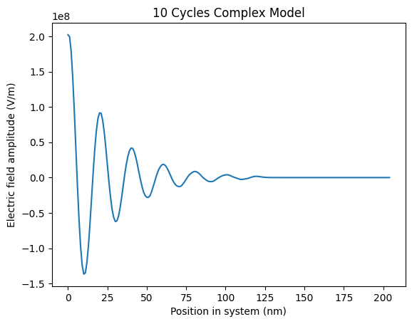
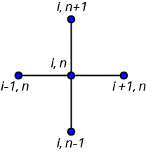
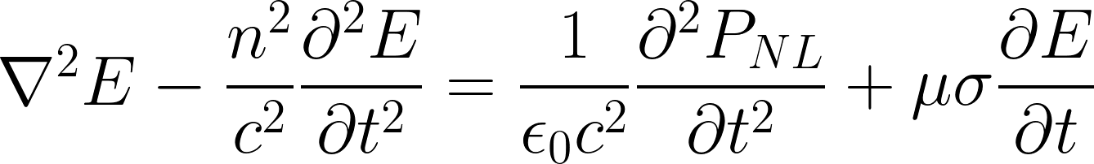
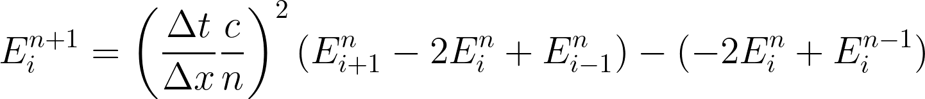
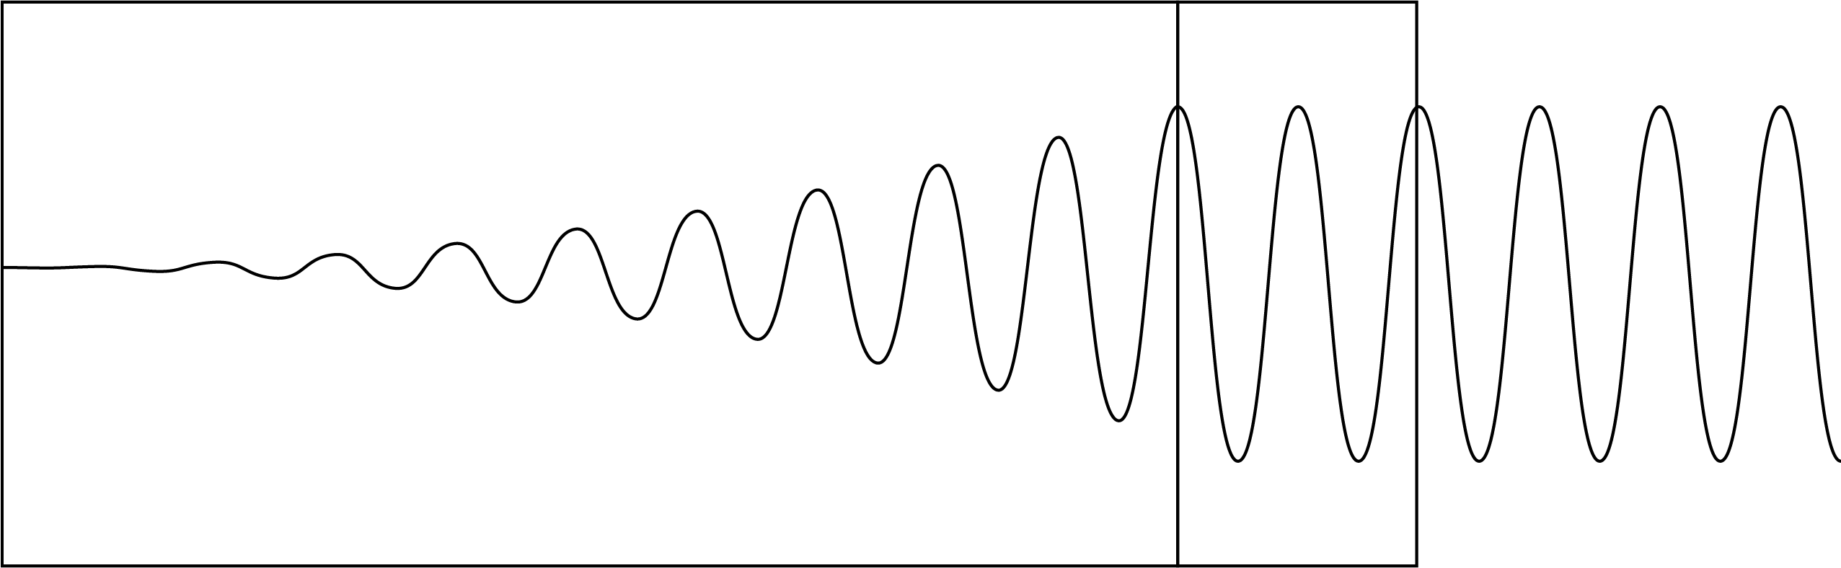

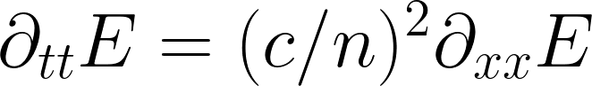
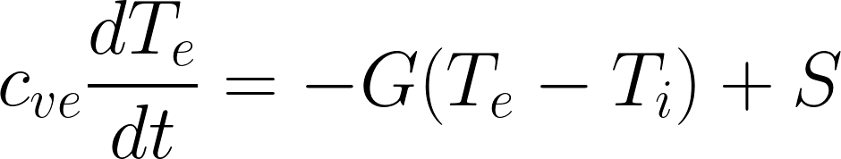

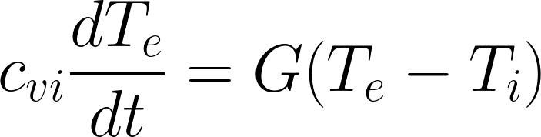
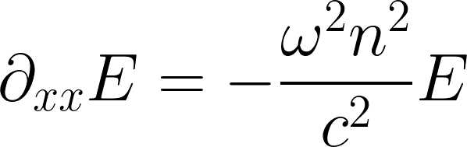

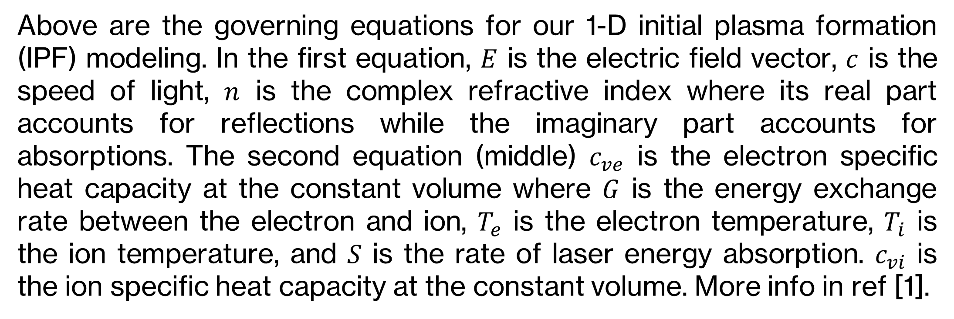
Implementation of a One-Dimensional Electromagnetic Wave Solver in Initial Plasma Formation Modeling
Nicholas Davila¹, Ka Ming Woo² ¹Department of Physics, College of Natural Sciences, The University of Texas at Austin
¹Princeton Plasma Physics Laboratory
²Laboratory for Laser Energetics, University of Rochester
Abstract
Methods and Figures
Conclusion and Results
The modeling of initial plasma formation (IPF) provides a pathway for understanding the ultrafast dynamics of laser–material interactions. A one-dimensional electromagnetic wave solver has been developed using the finite-difference time-domain (FDTD) method to accurately model laser propagation in metals and dielectrics. Laser absorption is modeled by the collisional damping of the light wave, which is determined by the dielectric function of the materials. A two-temperature model is employed to describe the heat transfer between electrons and lattices ions. Differences in the heat transfer dynamics to electrons and ions modeled by the wave solver and a ray trace approach are compared. The objective of this approach is to enhance the modeling accuracy of laser-matter interactions in inertial confinement fusion (ICF) codes.
We implemented an explicit Finite-Difference Time-Domain (FDTD) scheme to model the electromagnetic wave propagation in medium. The word “explicit” means that the time-step size “dt” is strictly controlled by Courant–Friedrichs–Lewy (CFL) condition so that the wave propagation distance within an allowed time-step size cannot exceed the grid size “dx”. Any form of hyperbolic PDEs are updated explicitly such as Euler equations in the computational fluid dynamics (CFD). The allowed wave propagation step size within a grid size “dx” is controlled by the CFL number.
Figure 2: Diagram of explicit finite difference scheme
Background
GHOST CELL
Figure 3: Simulation of light wave propagating into material undergoing collisional damping.
SIMULATION SPACE
As a light wave propagates inside a material, the light wave interacts with electrons and so the electrons are set into oscillations along the electric field vector direction. The oscillating electrons then collide with neighboring atoms and the light wave’s energy is then transferred from the electric field to electrons and then ions eventually. This process is known as the collisional damping of light waves and is described by a complex refractive index. The incident electric field is described by a complex number:
Using Python’s built in complex number storer, we implemented our finite-difference scheme for 10 cycles and were able to accurately model the decay of a 1-D light wave going into a material. The comparison of the heat transfer dynamics modeled by the wave solver compared to a ray trace approach are still in progress.
Future Work
Figure 1: Diagram of laser going into material and decaying. This was the outcome we were looking for. The rate of decay depends on the material, this is for demonstration purposes.
We model 1-D initial plasma formation to observe numerical performance of an explicit finite-difference solver. For our future work we can extend our solver to 2-D and 3-D by simply adding terms to our solver. We also plan to employ a two-temperate model to compare and describe the heat transfer between electrons modeled by the wave solver versus a ray tracing approach.
The complex-valued incident electric field provides the initial boundary condition in the ghost cells. The electric field inside the computational domain is initialized as:
References
However, the direct implementation of a complex refractive index leads to oscillatory numerical solutions. A Fourier analysis is applied to understand this phenomenon. In 1-D, the reduced wave equation becomes:
[1] Fedorov, M. V. (2016). L. V. Keldysh’s “Ionization in the Field of a Strong Electromagnetic Wave” and modern physics of atomic interaction with a strong laser field. Journal of Experimental and Theoretical Physics, 122(3), 449–455. doi:10.1134/S1063776116030043
Above are the governing equations for our 1-D initial plasma formation (IPF) modeling. In the first equation, $E$ is the electric field vector, $c$ is the speed of light, $n$ is the complex refractive index where its real part accounts for reflections while the imaginary part accounts for absorptions. The second equation (middle) $c_{ve}$ is the electron specific heat capacity at the constant volume where $G$ is the energy exchange rate between the electron and ion, $T_{e}$ is the electron temperature, $T_{i}$ is the ion temperature, and $S$ is the rate of laser energy absorption. $c_{vi}$ is the ion specific heat capacity at the constant volume. More info in ref [1].
The above equation accepts an exponentially decaying or growing solution. Where a positive sign in the refractive index corresponds to a growing solution whereas the negative sign corresponds to a decaying solution. For laser propagations in matter, the negative sign is the correct solution to describe an attenuating wave. During the numerical update, the selection of the sign depends on the boundary condition.
Acknowledgments
This material is supported by the Department of Energy National Nuclear Security Administration under Award No. DE-NA0003856. This work was made possible by funding from the Department of Energy for the Plasma and Fusion Undergraduate Research Opportunities (PFURO) program. This work is supported by the US DOE Contract No. DE-AC02-09CH11466.

